Slide 1
Module 1
Introduction to Cloud
Cloud computing means using the internet to access computing services like servers, storage, databases, networking, software, and more. It is a modern alternative to using physical data centers at your own location.
With a traditional on-premises setup, you must handle everything yourself—buying and setting up hardware, installing software, managing networks, and maintaining the system.
In cloud computing, the cloud provider manages the hardware and offers various services that you can rent as needed. You only pay for what you use. Cloud platforms also provide simple online tools to help you manage your resources like storage, computing, and applications easily.

Slide 2
Advantages of Cloud Computing
Cost: Saves money by avoiding the need to buy expensive hardware and software.
Speed: Resources can be accessed quickly, often within minutes.
Scalability: Easily increase or decrease resources based on your needs.
Productivity: Less work is needed to manage systems—no need for patching or hardware maintenance.
Reliability: Fast and affordable data backup and recovery helps keep your business running smoothly.
Security: Cloud providers offer strong security measures to protect your data.

Slide 3
Types of Cloud Computing (Deployment Models)
Public Cloud:
Open for anyone to use.
Services like storage and software are provided by third-party companies over the internet.
Private Cloud:
Used only by one organization.
Can be hosted in the company's own data center or by an outside provider.
Hybrid Cloud:
Combines both public and private clouds.
Allows sharing of data and applications between them.
Offers more flexibility and choices for businesses.

Slide 4
Types of Cloud services
1. Infrastructure as a Service (IaaS)
You rent basic IT resources like servers, storage, and networks from a cloud provider.
You can create virtual machines (VMs) with Windows or Linux and install anything you need.
The cloud provider manages the hardware and virtualization.
You manage everything else (OS, applications, security, etc.).
It gives high flexibility, but also requires more effort to maintain.
2. Platform as a Service (PaaS)
PaaS offers a ready-to-use environment for developing, testing, and running software.
Developers focus only on the application, while the cloud provider manages the platform.
It gives less flexibility than IaaS, but easier setup and less maintenance.
3. Software as a Service (SaaS)
Provides ready-to-use software over the internet.
Software is hosted and managed by the provider.
Users access it on demand, usually through a subscription.
Helps reduce operational costs.
Examples: Microsoft OneDrive, Dropbox, WordPress, Amazon Kindle.

Slide 5
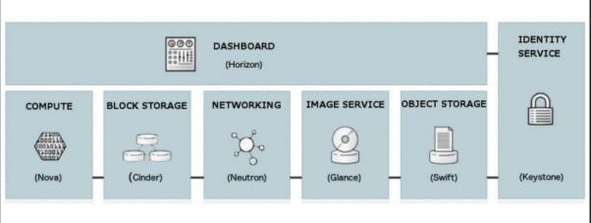
Introducing the OpenStack logical architecture
OpenStack services are mainly developed in Python for fast development.
All services offer REST APIs for external communication.
These APIs are used by both end users and other OpenStack services.
Each service may have multiple components.
Components within a service communicate using a message queue.
The message queue offers benefits like:
Queuing of requests
Loose coupling between components
Load distribution among worker processes

Slide 6
1. Keystone - identity management
Keystone is a core component of OpenStack that handles identity services, including authentication and authorization of users. It ensures that only the right users or services can access other OpenStack services. Keystone supports various authentication methods like username/password and token-based systems. It can also connect to existing systems such as LDAP and PAM. Additionally, it provides a service catalog that lists all available OpenStack services.
2. Swift - object storage
Swift is a storage service in OpenStack that provides object-based storage and can be accessed using REST APIs. It stores data as objects, which are split into smaller parts and saved in separate containers. These containers are copied across multiple storage nodes to ensure high availability, automatic recovery, and easy scalability.

Slide 7
3. Cinder - block storage
Cinder is a service in OpenStack that provides persistent block storage for virtual machines. It offers raw volumes that act like hard disks for VMs
Key features of Cinder:
Create and delete volumes
Create and delete volume snapshots
Attach or detach volumes to/from instances
Clone volumes
Create volumes from snapshots
Copy data between volumes and images
4. Manila - File share
Manila is a file-sharing storage service in OpenStack that provides remote file system access, similar to NFS or SAMBA used in Linux. Unlike Cinder, which works like SAN, Manila supports NFS, SAMBA, and CIFS as backend drivers. It manages and organizes file shares on shared servers.

Slide 8
5. Glance - Image registry
Glance is an OpenStack service that manages virtual machine images and their metadata. It allows users to upload, discover, and retrieve images using REST APIs.
Glance stores and tracks VM images and metadata (like disk format, kernel, etc.).
It supports multiple image formats for different hypervisors (e.g., KVM, XEN, VMware, Docker).
Images can be stored in various backbends like local directories, NFS, or even Swift.
Swift is an object storage service used to store data like images, backups, and archives.
While Swift handles scalable storage, Glance acts as an image registry and focuses on managing and querying image data.
A typical use case: a client uploads a VM image via Glance, which then stores it using a backend like Swift.
As an operator, the goal is to choose the right storage backend to balance cost and performance.
6. Nova-Compute service
Nova is a core component of OpenStack that provides the compute service. It manages virtual machines based on user requests. Nova is complex because it interacts with many other OpenStack services and components to handle tasks like launching and managing VMs.

Slide 9
7. Nova-api
Nova-api handles requests from users or other services. It processes API calls to create and manage virtual machine instances.
8. Nova-compute
Nova-compute is a worker service that creates and deletes virtual machines using hypervisor APIs like XenAPI, Libvirt (for KVM), or VMware API.
9. Nova-network
Nova-network handles networking tasks like setting up bridges and managing IP rules. These tasks come from a queue. Neutron is now used instead of nova-network for advanced networking.
10. Nova-scheduler
Nova-scheduler picks the best compute host to run a new VM by processing requests from a queue. It helps improve system performance by choosing the most suitable host.

Slide 10
11. Nova-conductor
Nova-conductor manages database access for compute nodes, keeping them from directly accessing the database. This improves security if a compute node is compromised.
Nova works with other OpenStack services like:
Keystone for authentication
Glance for accessing VM images
Horizon for the web interface
For example, nova-api sends image requests to Glance, and nova-compute downloads those images to launch VMs.
Nova also offers console services (like nova-console, nova-novncproxy, and nova-consoleauth) that let users access VM consoles through a web interface.
12. Neutron - Networking services
Neutron provides Network-as-a-Service (NaaS) in OpenStack, connecting devices managed by services like Nova.
Key features of Neutron:
Lets users create custom networks and connect servers to them
Has a pluggable backend to support both standard and vendor-specific hardware
Supports extensions for adding extra network services
Offers core features for routers, virtual switches, and SDN controllers, which continue to improve over time

Slide 11
The Neutron architecture
The three main components of the Neutron architecture are:
Neutron server:
Neutron accepts API requests and forwards them to the correct plugin to take action.
Neutron plugins: They handle the actual tasks like:
Connecting or disconnecting ports
Creating networks and subnets
Assigning IP addresses
Neutron agents run on compute and network nodes. They receive instructions from Neutron plugins and apply changes to the nodes. Different agents handle different network functions.
Neutron manages network connectivity between OpenStack instances. It prevents the network from becoming a bottleneck and allows users to manage their own network settings. Neutron supports vendor integrations and can be extended with plugins to use different networking technologies through its API.

Slide 12
Ceilometer, Aodh, and Gnocchi – Telemetry
Ceilometer provides metering in OpenStack, which is important in shared, multi-tenant environments. It collects usage data for resources like VMs, disks, networks, and routers. Each resource is linked to a meter, and data is stored as samples using meter-defined units. Ceilometer can summarize this data and collect it from various sources like message buses, polling, and agents.
The Alarming feature has been moved to a new project called Aodh, which handles alarms based on usage data and events.
Another proposed improvement is Gnocchi, a time-series database service for better telemetry data handling.
Heat – Orchestration
Heat is the orchestration service in OpenStack. It started with basic support for resources like compute, storage, images, and networks. Heat helps manage and automate cloud resources by creating stacks to quickly launch applications.
Users define these resources using HOT templates (Heat Orchestration Templates) written in YAML or JSON format, where proper indentation is important.

Slide 13
Horizon – Dashboard
Horizon is the web dashboard for OpenStack. It provides a user-friendly interface to manage all OpenStack services, including some experimental ones. Horizon is stateless and doesn’t store data, except for session info. It works by making API calls to OpenStack and showing the returned results.
Horizon is built using panels, which represent different services. These panels can be turned on or off based on what services are available. Horizon is also easy to customize using CSS.
Message Queue
The Message Queue acts as a central hub for passing messages between different service components. It allows these components to communicate asynchronously (without waiting for each other). A key benefit is that it can buffer requests and support both one-to-one (unicast) and group (multicast) communication.

Slide 14
The database
The database stores important information about the cloud, such as available instance types, running instances, networks, and projects. It keeps both build-time and run-time data, providing persistent storage to maintain the state of the cloud. It is a key part of how OpenStack components share information.
How OpenStack works by chaining all the service cores
The series of steps:
Authentication is the first action performed. This is where Keystone comes into the picture. Keystone authenticates the user based on credentials such as the username and password.
The service catalog is then provided by Keystone. This contains information about the OpenStack services and the API endpoints.
You can use the Openstack CLI to get the catalog: $ openstack catalog list. The service catalog is a JSON structure that exposes the resources available on a token request.
Typically, once authenticated, you can talk to an API node. There are different APIs in the OpenStack ecosystem (the OpenStack API and EC2 API):

Slide 15
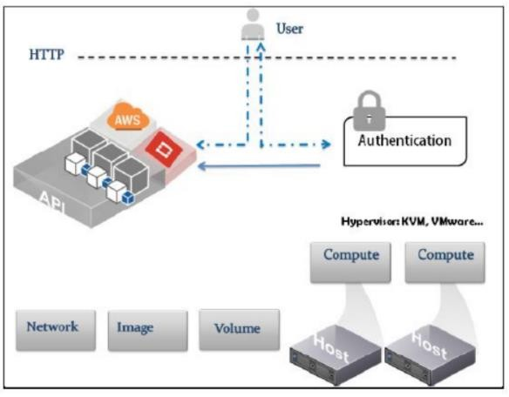
High-level view of how OpenStack works:
Another element in the architecture is the instance scheduler. Schedulers are implemented by OpenStack services that are architected around worker daemons. The worker daemons manage the launching of instances on individual nodes and keep track of resources available to the physical nodes on which they run. The scheduler in an OpenStack service decides the best candidate node to launch a virtual instance on. An example of this architecture is nova-scheduler.

Slide 16
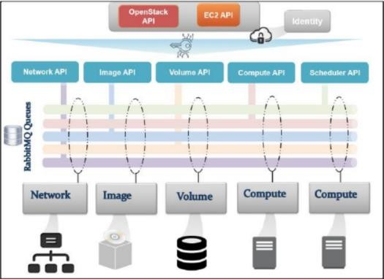
Provisioning a VM under the hood
How Different services in OpenStack work together, leading to a running virtual machine. How things work
– simple architecture diagram:
The process of launching a virtual machine involves the interaction of the main OpenStack services that form the building blocks of an instance including compute, network, storage, and the base image. OpenStack services interact with each other via a message bus to submit and retrieve RPC calls. The information of each step of the provisioning process is verified and passed by different OpenStack services via the message bus.

Slide 17
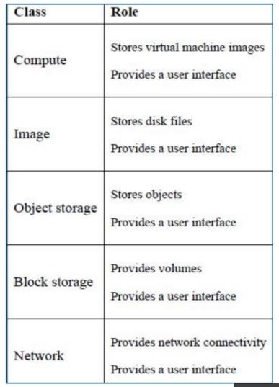
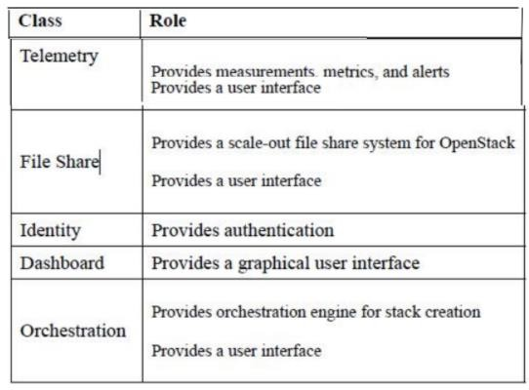
A sample architecture setup
There are three phases of design:
Designing a conceptual model
Designing a logical model,
Realizing the physical design.
The conceptual model design

Slide 18
Storage
Ephemeral storage is temporary and exists only while the instance is running.
It is used for non-critical data like cache, buffers, session data, or swap space.
Data is lost when the instance is stopped or deleted.
Best used when the VM's state is not important, such as in test environments.
For persistent storage, use:Cinder or Manila for block/shared storage
Swift for large amounts of important data needing replication and redundancy
The tenant data network
The data network provides the physical path for virtual networks created by OpenStack tenants. It keeps tenant traffic separate from the infrastructure communication used by OpenStack services.
The Storage network
The Storage Network offers dedicated physical connectivity for storage-related traffic between virtual machines and storage servers. Since this traffic can be heavy, it's best to isolate the storage network from both management and tenant networks to ensure better performance and reliability.

Slide 19
Virtual Network types
The External (Public) Network provides global connectivity using routable IP addresses. It enables VM instances to access the internet through a virtual router that performs Source Network Address Translation (SNAT). SNAT allows traffic from a private network to be routed out to the internet, and OpenStack supports this via Neutron APIs.
In addition, Destination NAT (DNAT) can be used to route external traffic to services running on VM instances.
When using VLANs, multiple networks can share a single Network Interface Card (NIC) by tagging them. For simplicity, the public network can remain untagged on that NIC, allowing easier access to the OpenStack dashboard and public API endpoints.

